Slide 1
Logistic Regression
Logistic Regression predicts the chance wether something is true or false
Here a function is fit instead of a line which goes from 0 to 1
It is usually used or classification
can work with continuous data (weight age) and decrete data (genotyp)

Slide 2
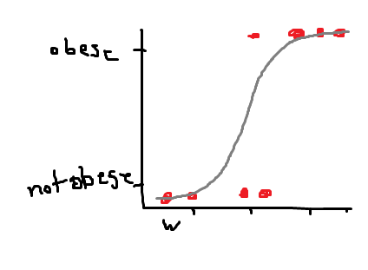
line is fit differently (by calculating maximum likelyhood)
pick a propability scaled by e.g., weight of observing an e.g., obese mouse
Do that for all the other mice with the same line.
Sum it up => likelihood of the data
Shift the line and repeat until best line is found.

